Slide 1

Manufacturing Line Productivity Enhancement
Presented by
Soliman Dawod Soliman
Mohamad Emad Eldin Abdelkhalek
Abdelrahman Rafat Abdelkawy
Ahmed Hisham Ahmed
Ibrahim Mohamad Sabry
Ahmed Khorshid Abdelhameed
Date: 17/5/2025

Slide 2
Brief Description of the Problem Being Solved
Manufacturing facilities often face unplanned downtimes due to various factors such as operator Error,
machine malfunction, and process inefficiencies. These downtimes lead to significant losses in productivity, increased operational costs, and reduced throughput.
Overview of the Proposed Solution
This project involves creating an interactive and insightful Power BI dashboard that tracks and analyzes downtime events in a production line. The solution consolidates various metrics, including downtime duration, causes, operator-related errors, and product-wise batch performance. By using dynamic visualizations, it enables users to identify patterns, root causes, and performance bottlenecks.
Unique Value Proposition
Actionable Insights: The dashboard helps decision-makers pinpoint which factors and operators contribute most to downtime.
Product-Level Analytics: Enables targeted improvements by analyzing which products are most affected by downtime.
Interactive Visuals: Unlike static reports, this dashboard allows real-time filtering and exploration of data for deeper insights.

Slide 3
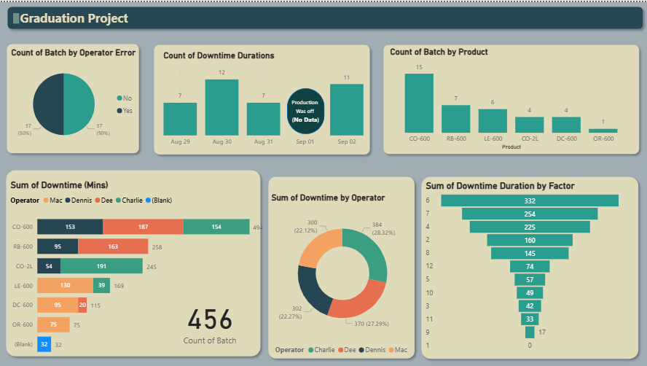

👤 Onboarding
📊 Dashboard View
🖱️ Data Interaction
📤 Reporting & Export
User Experience Highlights:
✓ Easy Navigation: Simple and intuitive layout.
✓ Interactive charts:
✓ Personalized: Tailored content based on user behavior.
Visual responses to user actions.

Slide 4
👥 Primary User Personas:
Production and continuous improvement engineers
Factory managers and line supervisors
Data analysts in manufacturing
✨ Key Features:
User-friendly dashboard
Interactive data visualization
Export and reporting tools
🎯 How These Features Solve User Problems:
Saves engineers time
Helps managers make data-driven decisions quickly
Improves accuracy in performance tracking and early problem detection

Slide 5

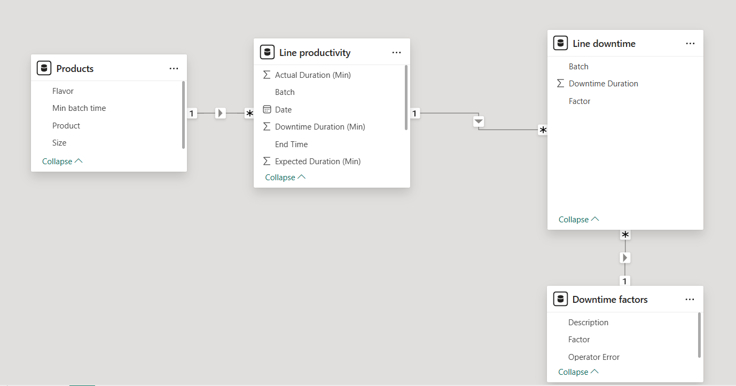
📂 Database Architecture:
Based on Excel files (flat file structure)
🔗 Relationships:
Products ↔ Line Productivity: Linked via Product
Line Productivity ↔ Line Downtime: Linked via Batch
Line Downtime ↔ Downtime Factors: Linked via Factor
🔑 Key Entities:
Typical columns include:
Production Line
Date
Quantity Produced
Actual Production Time
Downtime
Line Efficiency
🔁 Data Flow:
Collection: Upload Excel file from the production team
Processing: Clean columns, handle missing values
Analysis & Display: Calculate KPIs ,generate visual reports
Model View

Slide 6
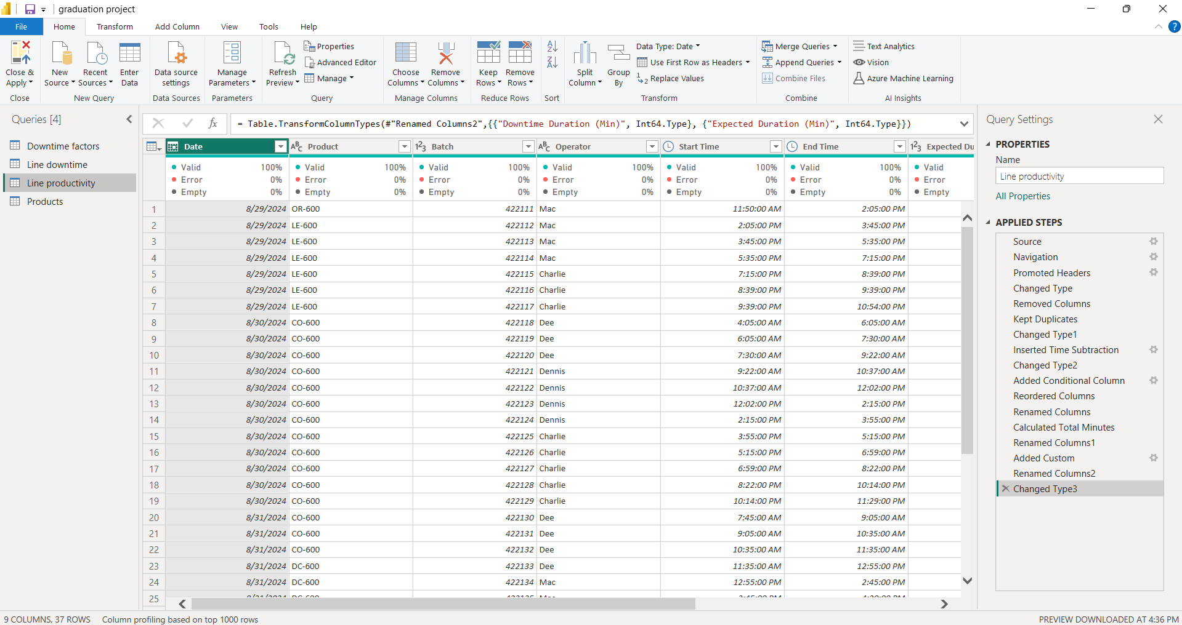
Data Cleaning & preparation
(Power Query)

Slide 7
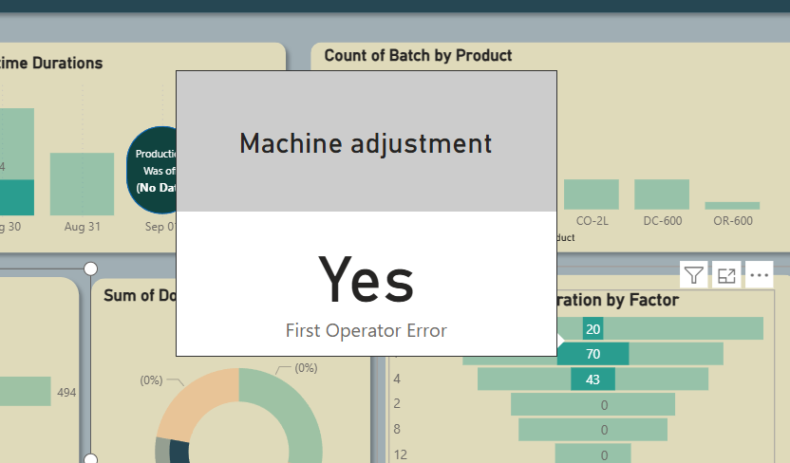
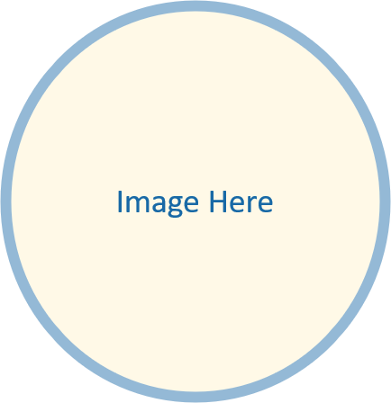
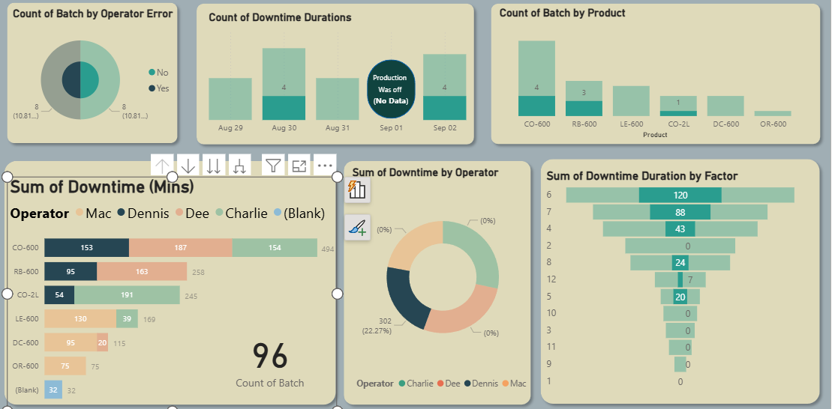

Interactive Visuals
Canvas(tooltip):
Actionable Insights:

Slide 8
Visualization and Reporting:
• Create an interactive dashboard using Power BI
• Provide visual representations of factors affecting downtime
Tools and Technologies:
• Data Cleaning: Power Query
• Visualization Tools: Power BI
Milestones and Deadlines:
Week 1: Build data model, clean, and preprocess data. (20-3-2025)
Week 2: Define analytical questions. (27-3-2025)
Week 3: Develop predictive models and analyze downtime data. (3-4-2025)
Week 4: Create an interactive dashboard and prepare the final report. (10-4-2025)

Slide 9
Team Members and Roles:
• Ahmed Hisham - Data Analyst
• Soliman Dawood –Data Visualization Specialist
• Mohamed Emad –Data Modeling: Built data models and created relationships between tables
• Ahmed Khorshid –Data Analyst
• Abdelrhman Raafat – Data Analyst
• Ibrahim Sabry -Data Cleaner:: Cleaned and prepared raw data for analysis
Collaboration Methods
WhatsApp was used as the primary tool for daily communication among team members and for quickly exchanging information.
Regular meetings were held via Zoom and Microsoft Teams to discuss project progress, assign tasks, and make decisions collaboratively.
This approach helped enhance coordination among team members and ensured that the project stayed on schedule.
The team adopted the Agile methodology, using elements of Scrum to organize tasks, manage progress, and promote continuous collaboration.

Slide 10
Thank you for your attention!
-Contact: solimand470@gmail.com
ahmedhish2367605@gmail.com
-Questions and feedback are welcome.

